Slide 1
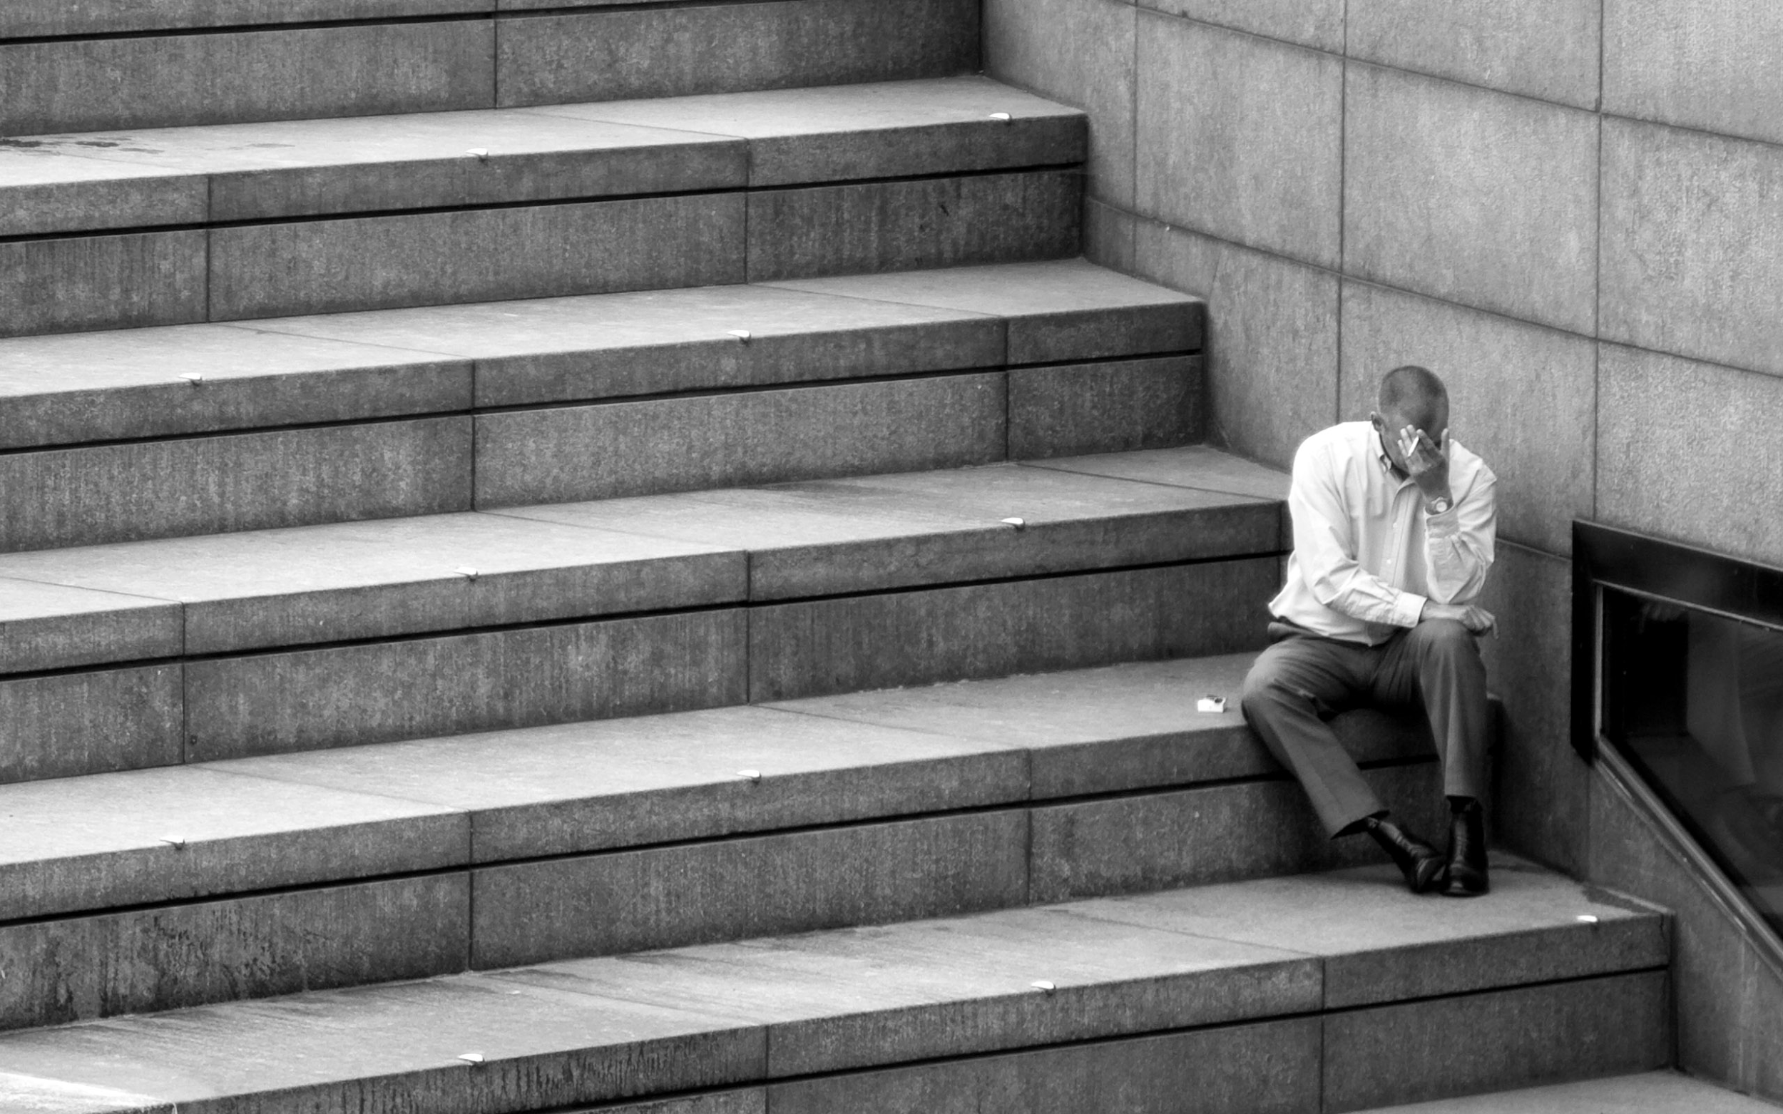
A LOOMING CRISIS:
THE U.S. UNEMPLOYMENT RATE IN FIGURES
A Time Series Analysis of the U.S. Unemployment Rate and the initial impact of the COVID-19 pandemic
Hardi Winata (S3794905)
Cha Rioflorido (S3789114)
Keavatey Srun (S3767615)
Meng Heng Ea (S3716021)

Slide 2
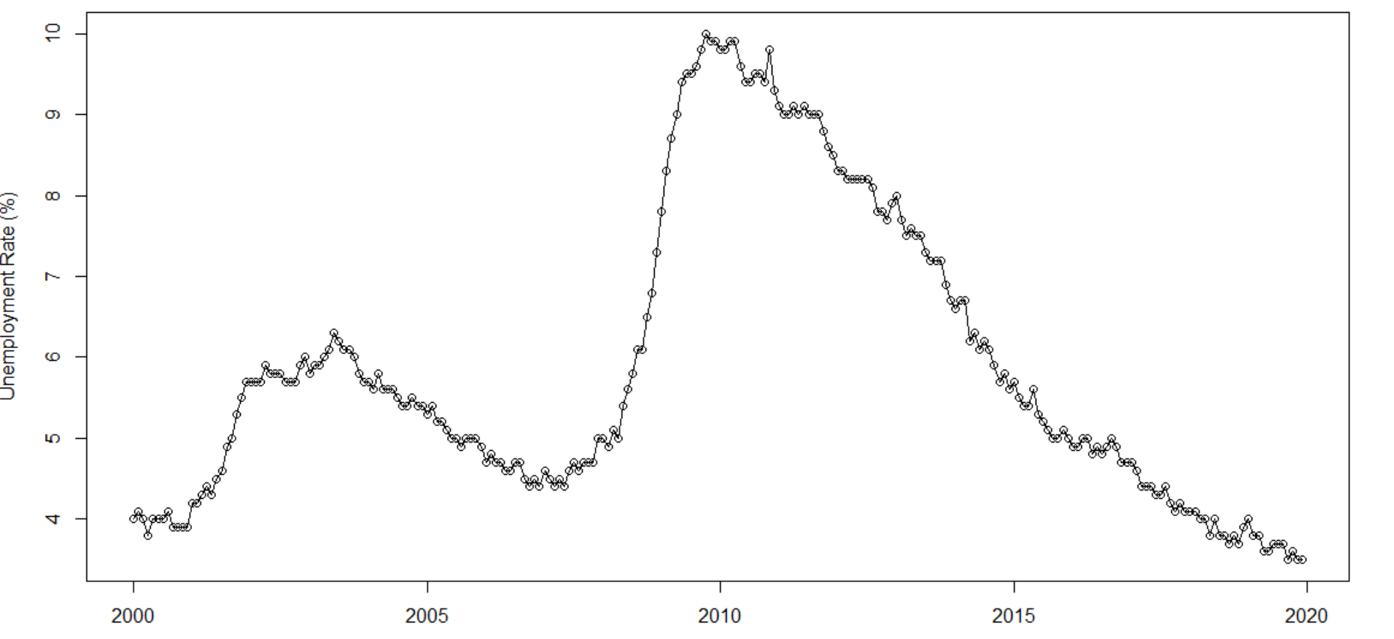
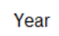
DESCRIPTIVE ANALYSIS
Unemployment rate continues on a downward trajectory, but the impact of COVID-19 looms to reverse the trend and possibly follow the Great Recession.
Monthly Unemployment Rate in the U.S. from January 2000 to December 2019
Overall Trends
2 intervention points from 2000
Unemployment rate as a lagging indicator - delayed spike and prolonged effect whilst on recovery period
Downward trend post the 2008 Great Recession
Findings (Period 2010-2019)
Non-stationary (p = 0.99)
No cyclical component
Highly-correlated (R = 99.8%)
Slightly changing variance
Not normally distributed (p < 0.01)
1995-2001
Dot.com bubble
2008-2009 Great Recession (or GFC)
Post-Great Recession, Pre-COVID-19
(Forecast inputs)
2020
COVID-19
pandemic

Slide 3
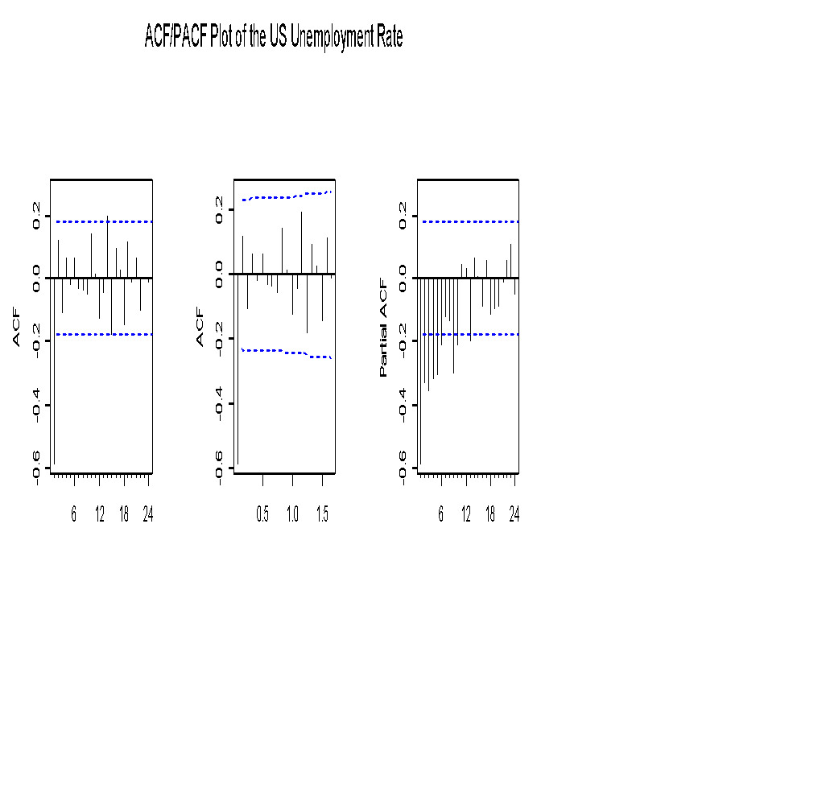
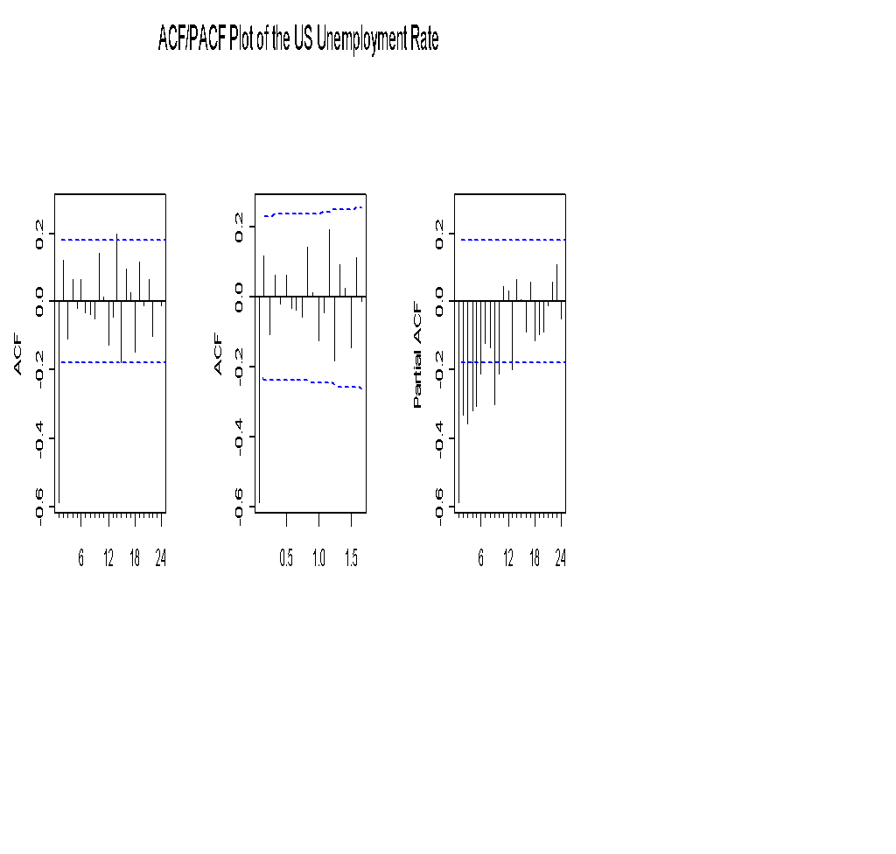
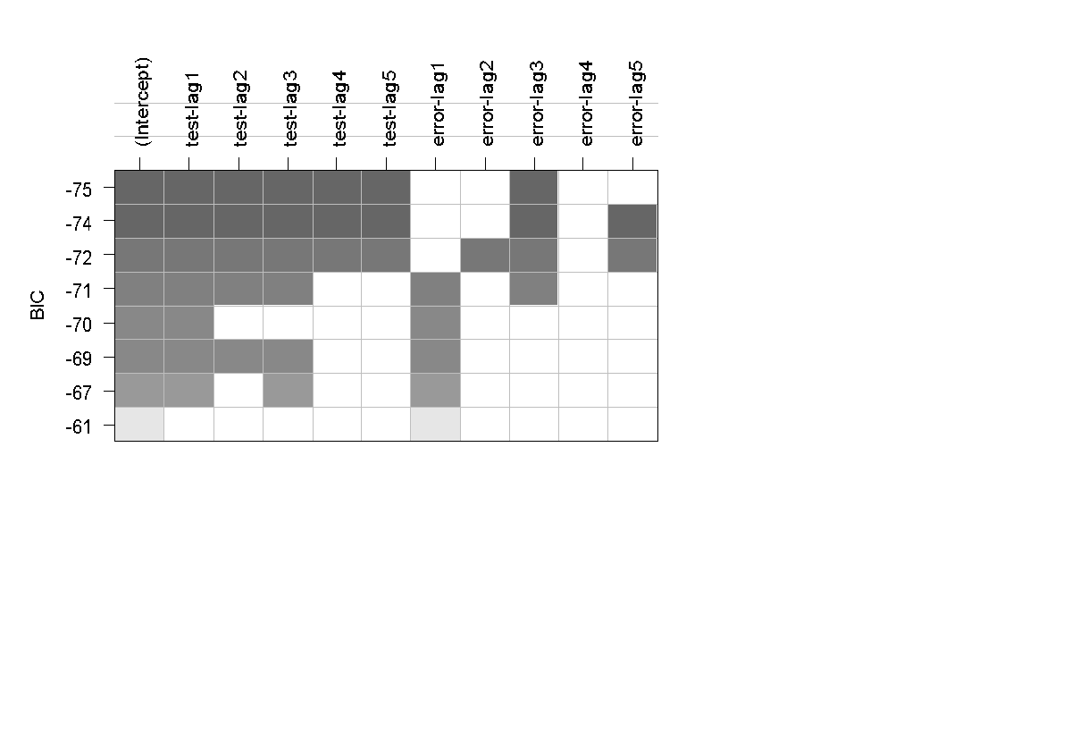
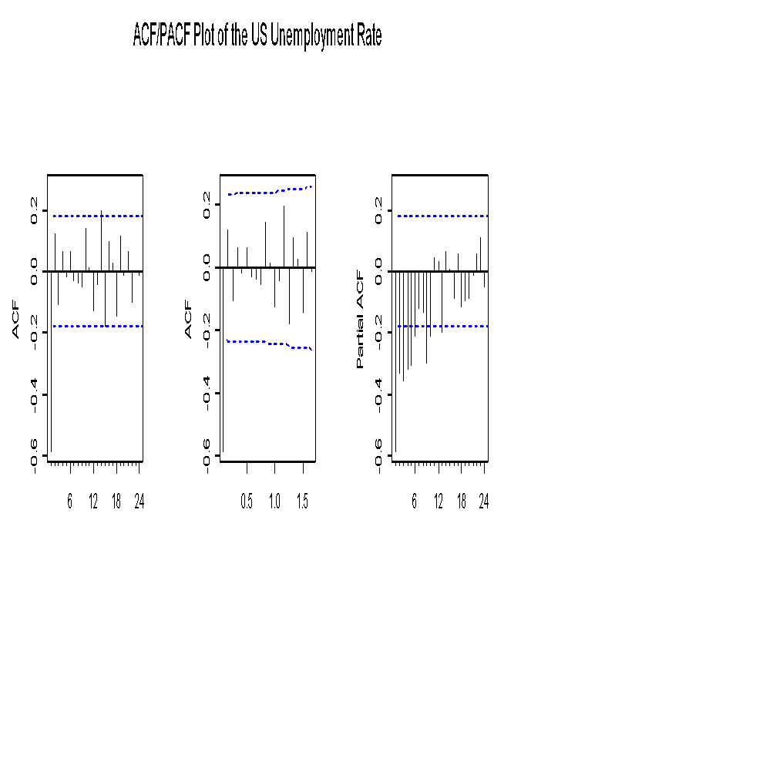
MODEL SPECIFICATION
7 models were identified from the ACF/PACF, EACF, and BIC plots
Correlograms
ARIMA (0,2,1)
Extended Autocorrelation Function
ARIMA (0,2,2)
ARIMA (1,2,1)
ARIMA (1,2,2)
Bayesian Information Criterion
ARIMA (3,2,3)
ARIMA (5,2,3)
ARIMA (5,2,5)
AR/MA | 0 | 1 | 2 | 3 | 4 | 5 | 6 | 7 | 8
0 | x | o | o | o | o | o | o | o | o
1 | x | x | o | o | o | o | o | o | o
2 | x | x | x | o | o | o | o | o | o
3 | x | o | o | o | o | o | o | o | o
4 | x | o | x | o | o | o | o | o | o
5 | x | o | x | o | o | o | o | o | o
6 | x | x | o | x | o | o | o | o | o
7 | x | o | o | x | o | o | o | o | o
8 | x | x | x | x | o | o | o | o | o
9 | x | x | o | o | o | o | o | o | o
10 | x | o | x | o | o | o | o | o | o

Slide 4
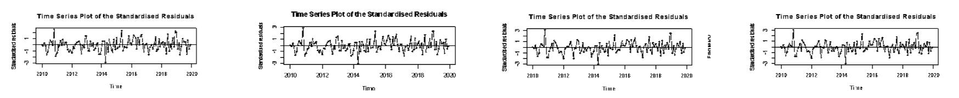

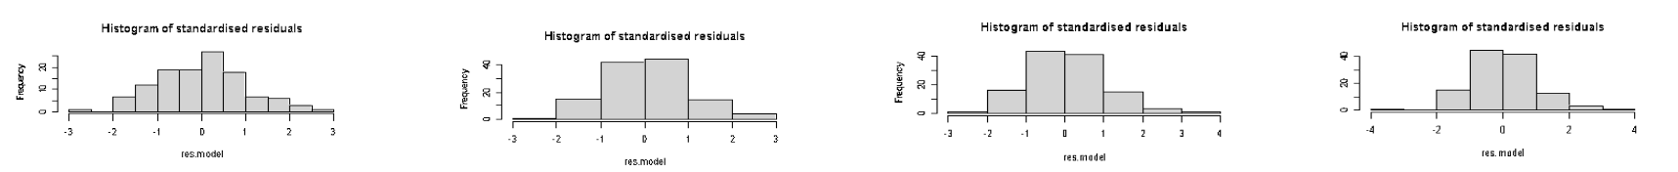
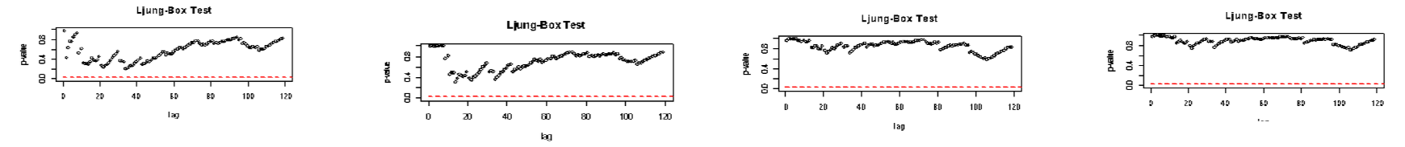
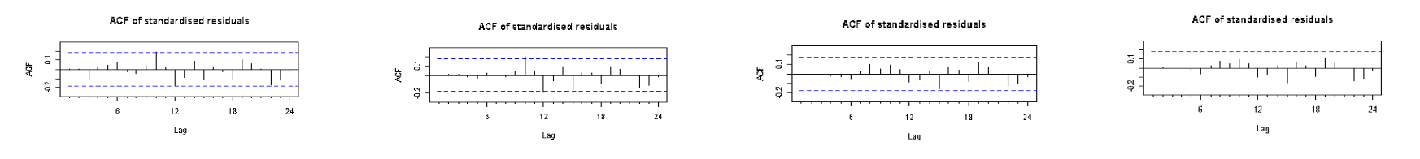
MODEL DIAGNOSTICS
4 out of the 7 models identified have independent and identically distributed residuals
ARIMA(1,2,2) | ARIMA(3,2,3) | ARIMA(5,2,3) | ARIMA(5,2,5)
Time Series White noise
Histogram Normally distributed
Ljung-Box p-values Uncorrelated
ACF No significant lags
Notes:
I.i.d = independent and identically distributed

Slide 5
PARAMETER ESTIMATION and MODEL SELECTION
ARIMA (1,2,2) is the best model based on the scores
Model | df | AIC | BIC | AICc
ARIMA(1,2,2) | 4 | -367.3105 | -356.2278 | -368.9566
ARIMA(3,2,3) | 7 | -364.2425 | -344.8477 | -365.2244
ARIMA(5,2,3) | 9 | -369.1023 | -344.1662 | -369.4357
ARIMA(5,2,5) | 11 | -365.2436 | -334.7760 | -364.753
Parameter Estimation
Overfitting – ARIMA(2,2,2) and ARIMA(1,2,3)
 | Estimate | Std. Error | z value | Pr(>|z|)
AR1 | 0.31688 | 0.15026 | 2.1089 | 0.03495
MA1 | -1.65912 | 0.10764 | -15.4138 | < 2.2e-16
MA2 | 0.68445 | 0.10878 | 6.2922 | 3.13E-10
 | Estimate | Std. Error | z value | Pr(>|z|)
AR1 | 0.296068 | 0.162873 | 1.8178 | 0.0691
AR2 | -0.047571 | 0.111326 | -0.4273 | 0.6691
MA1 | -1.628738 | 0.135909 | -11.984 | < 2.2e-16
MA2 | 0.656398 | 0.135109 | 4.8583 | 0.000001184
AR1 | 0.23643 | 0.320806 | 0.737 | 0.4611
MA1 | -1.57331 | 0.314566 | -5.0015 | 5.69E-07
MA2 | 0.551902 | 0.463402 | 1.191 | 0.2337
MA3 | 0.049744 | 0.166083 | 0.2995 | 0.7645

Slide 6
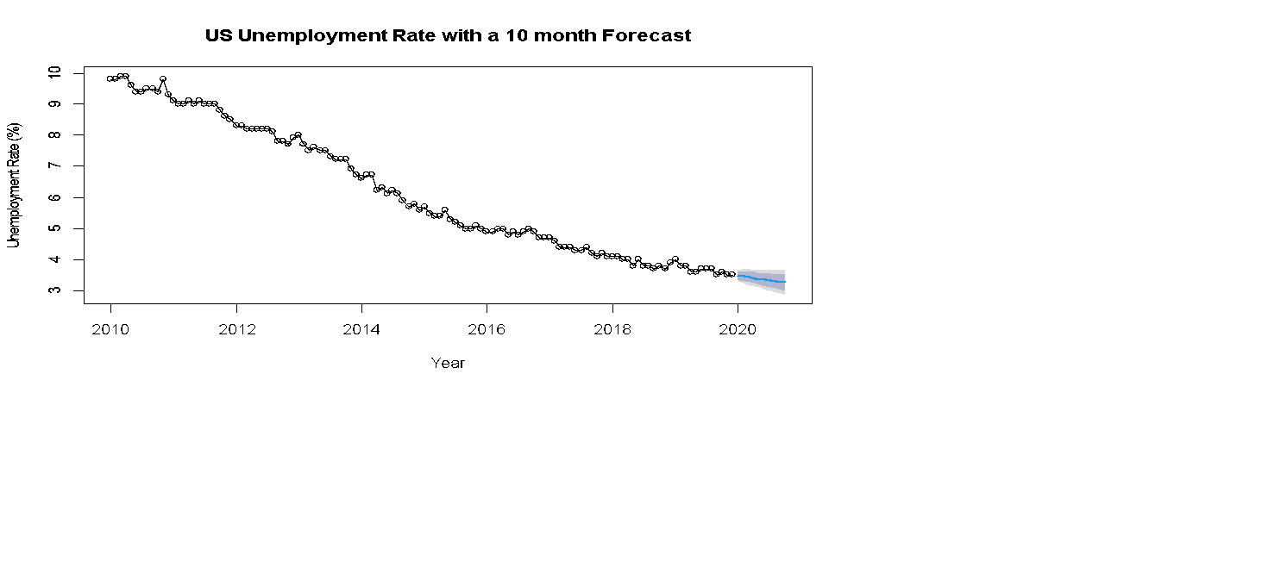


FORECAST
From a bullish forecast to a bearish outcome
10-month Forecast of the Unemployment Rate in the U.S. from December 2019
Month | Jan-20 | Feb-20 | Mar-20 | Apr-20 | May-20 | Jun-20 | Jul-20 | Aug-20 | Sep-20 | Oct-20
Forecast | 3.48 | 3.45 | 3.43 | 3.41 | 3.38 | 3.36 | 3.33 | 3.31 | 3.28 | 3.26
Low 95% CI | 3.29 | 3.23 | 3.18 | 3.14 | 3.09 | 3.05 | 3 | 2.96 | 2.91 | 2.86
Up 95% CI | 3.67 | 3.69 | 3.69 | 3.68 | 3.68 | 3.68 | 3.68 | 3.68 | 3.68 | 3.68
Actual data | 3.60 | 3.50 | 4.40 | 14.70 | - | - | - | - | - | -
Difference | 0.12 | 0.05 | 0.97 | 11.29 | - | - | - | - | - | -
Notes:
https://tradingeconomics.com/united-states/unemployment-rate
https://www.fragomen.com/insights/alerts/president-trump-orders-european-travel-ban-starting-1159-pm-edt-friday-march-13

Slide 7
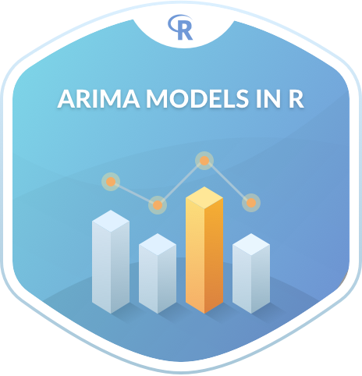
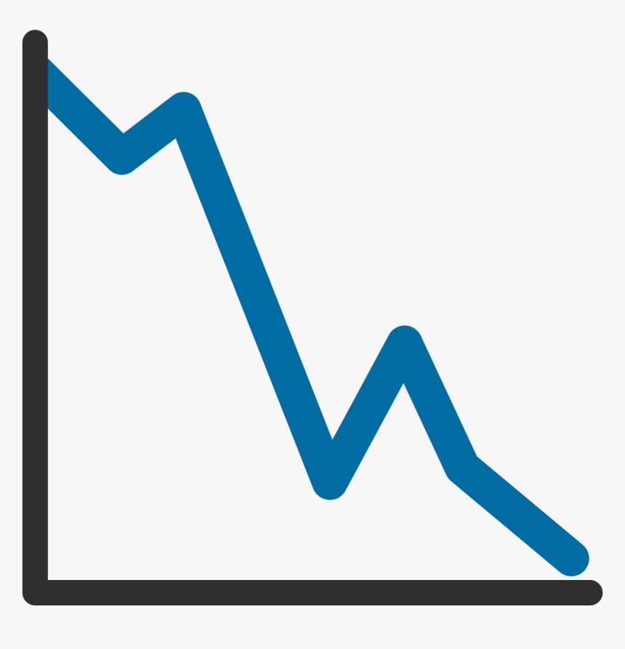

SUMMARY AND NEXT STEPS
The turning point has arrived, and the worst has yet to come
Pre-COVID-19: Unemployment rate in the U.S. has been declining steadily and was forecasted to continue its decline.
The true effect is yet to be determined as the number of infections is still on the rise.
Improve initial model as more data is collected, as well as perform intervention analysis to assess full impact of COVID-19 pandemic.

